Slide 1
Neural Networks 2023-2024
LAB 3

Slide 2
Agenda
Single Layer Perceptron
Decision Boundary
Bias
Adaline
Task 1 Description

Slide 3
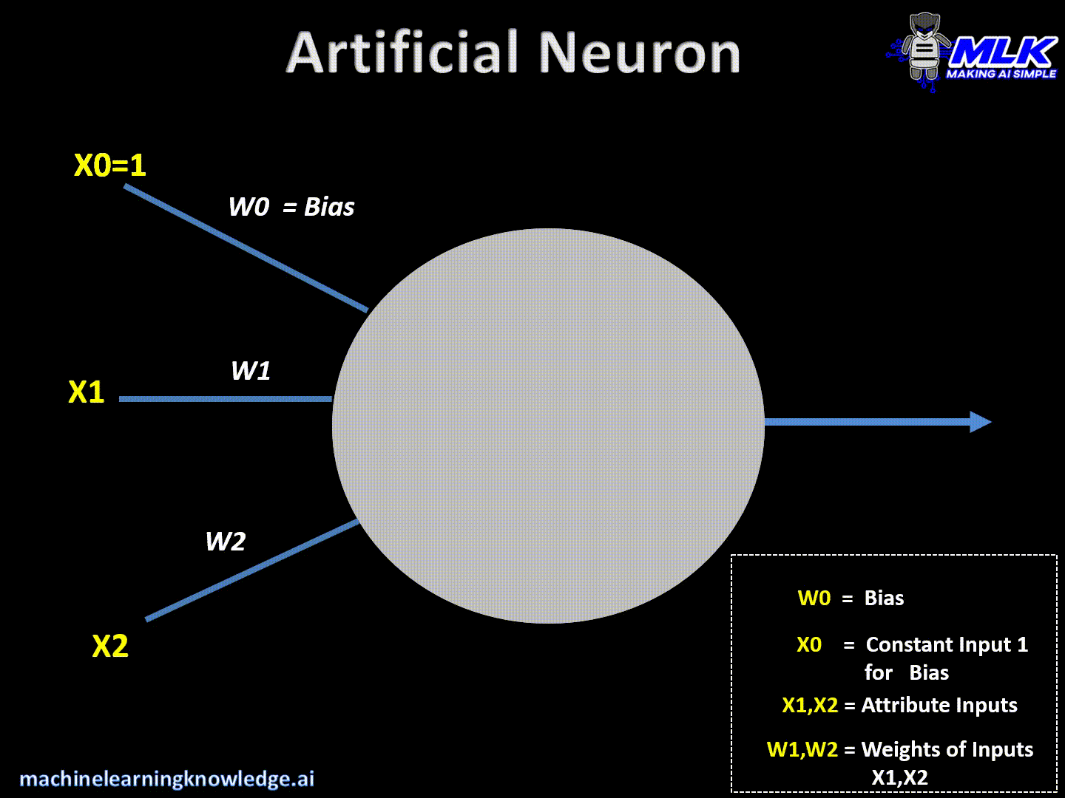
Neural Networks
Notes:
Input Layer :- This layer accepts input features. It provides information from the outside world to the network, no computation is performed at this layer, nodes here just pass on the information(features) to the hidden layer. Hidden Layer :- Nodes of this layer are not exposed to the outer world, they are the part of the abstraction provided by any neural network. Hidden layer performs all sort of computation on the features entered through the input layer and transfer the result to the output layer. Output Layer :- This layer bring up the information learned by the network to the outer world.

Slide 4
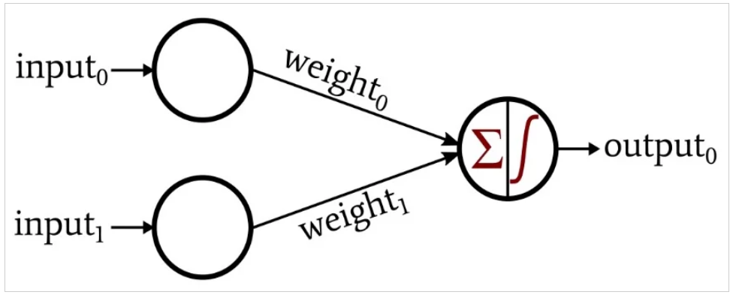
Single layer Perceptron
Any neural network consists of interconnected nodes arranged in layers. The nodes in the input layer distribute data, and the nodes in other layers perform summation and then apply an activation function.
The connections between these nodes are weighted, meaning that each connection multiplies the transferred datum by a scalar value.
Notes:
The network in the following figure, is a single layer network because it has only one layer that does computations (The input layer does not count)

Slide 5
Single layer Perceptron
Start with a randomly chosen weight vector w(0)
Repeat
For each training vector pair (𝑥_𝑖, 𝑡_𝑖)
evaluate the output 𝑦_𝑖 when 𝑥_𝑖 is the input according to 𝑦_𝑖 = signum 〖[𝑤(𝑖)〗^𝑇. 𝑥(𝑖)+𝑏]
if 𝑦_𝑖 ≠ 𝑡_𝑖 then
calculate loss L = (𝑡_𝑖 - 𝑦_𝑖)
form a new weight vector wi+1 according to
𝑤_(𝑖+1) = 𝑤_𝑖 + η.(𝑡_𝑖 - 𝑦_𝑖).𝑥_𝑖
else
do nothing
end if
End for
Until the stopping criterion (convergence) is reached

Slide 6
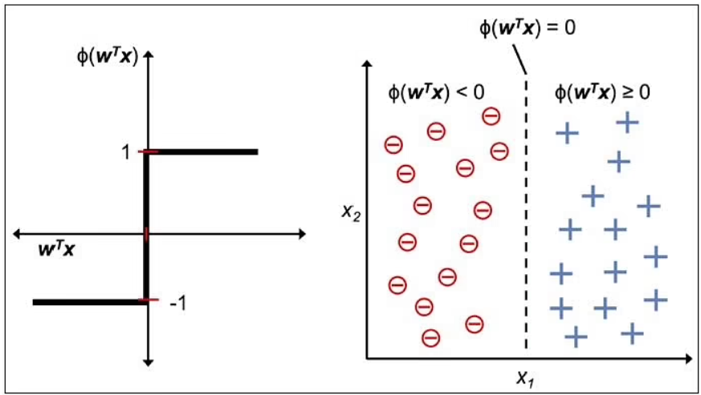
Single layer Perceptron – Decision Boundary
A decision boundary is a hyperplane that separates the data points into specific classes, where the algorithm switches from one class to another. On one side a decision boundary, a datapoints is more likely to be called as class A — on the other side of the boundary, it’s more likely to be called as class B.

Slide 7
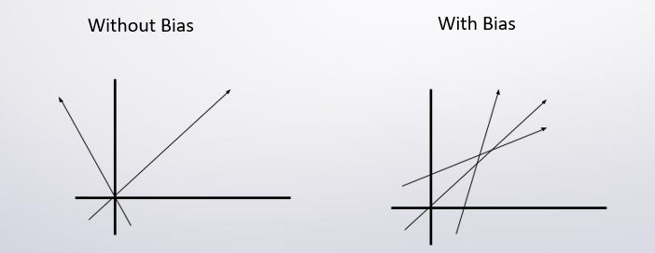
Single layer Perceptron – Bias
Bias is simply a constant value (or a constant vector) that is added to the product of inputs and weights. Bias is utilized to offset the result.
The bias is used to shift the result of activation function towards the positive or negative side.
Notes:
Due to absence of bias, model will train over point passing through origin only, which is not in accordance with real-world scenario. Also with the introduction of bias, the model will become more flexible.

Slide 8
Adaline Algorithm
Stands for “Adaptive Linear Neuron”.
This is the point where Adaline really deviates from Perceptron because there is no cost function in Perceptron and without a cost function Perceptron is minimizing nothing.
This is why Adaline is considered as an improvement of Perceptron as you can see how it is improving its prediction by simply looking at its cost function.
Gradient Descent: It is a first order iterative optimization algorithm for finding a local minimum of differential function.

Slide 9
Adaline Algorithm
Stands for “Adaptive Linear Neuron”.
The Adaline deviates from Perceptron because there is no cost function in Perceptron and without a cost function Perceptron is minimizing nothing.
The cost function in the Adaline Algorithm is mean square error.
To minimize cost function, gradient descent is needed.
The gradient decent should work with differentiable function (has derivative) as the weight update is on the slope’s opposite direction

Slide 10
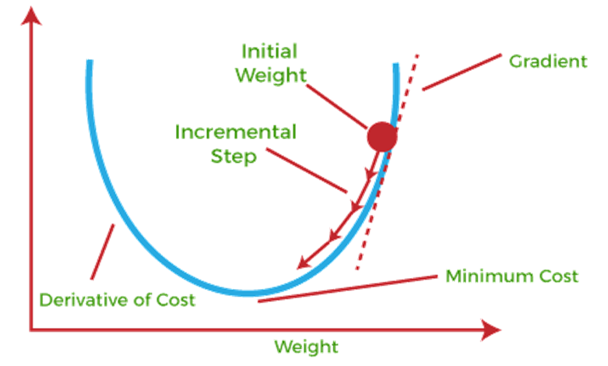
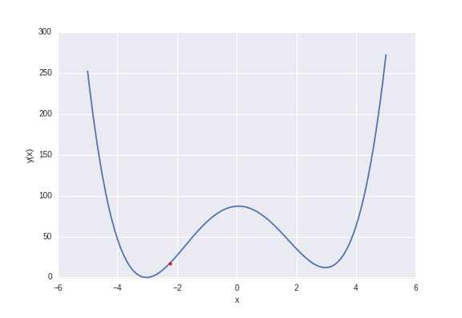
Gradient Descent
It is a first-order optimization algorithm. To find a local minimum of a function, one takes a step proportional to the negative of the gradient of the function at the current point.
If this step size, Learning rate, is too large, we will overshoot the minimum, that is, we won’t even be able land at the minimum. If learning rate is too small, we will take too many iterations to get to the minimum. So, learning rate needs to be just right.

Slide 11
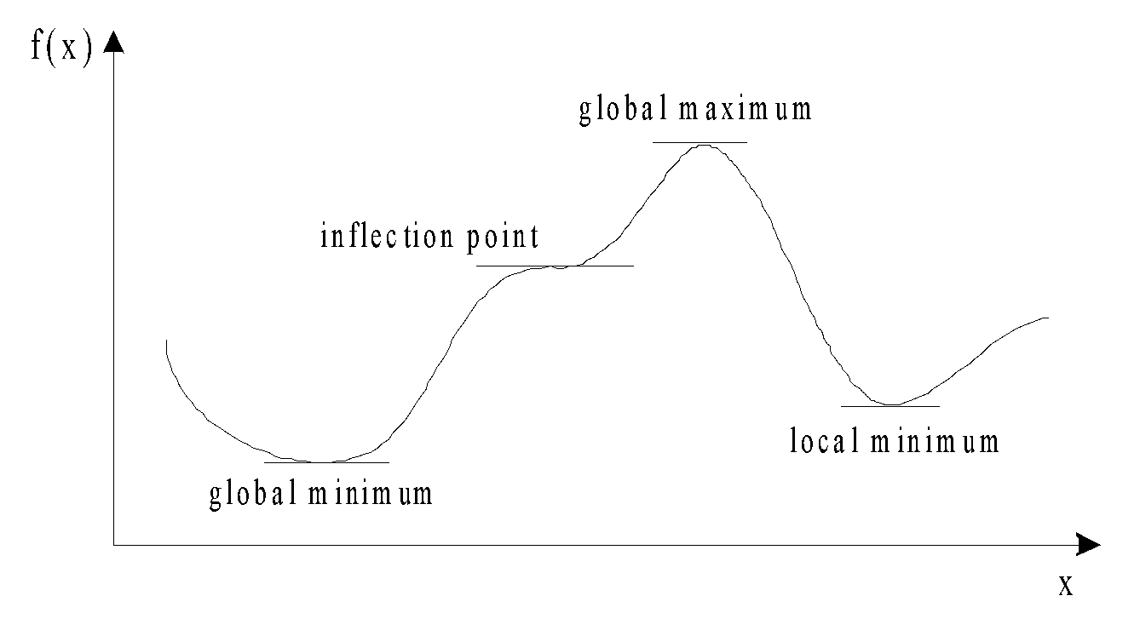
Gradient Descent
Gradient is the slope of a function.
Optimization is finding the “best” value of a function which is the minimum value of the function.
The number of “turning points” of a function depend on the order of the function.
Not all turning points are minimum.
The least of all the minimum points is called the “global” minimum.
Every minimum is a “local” minimum
We use the gradient descent to find which weights and biases minimize the cost function

Slide 12
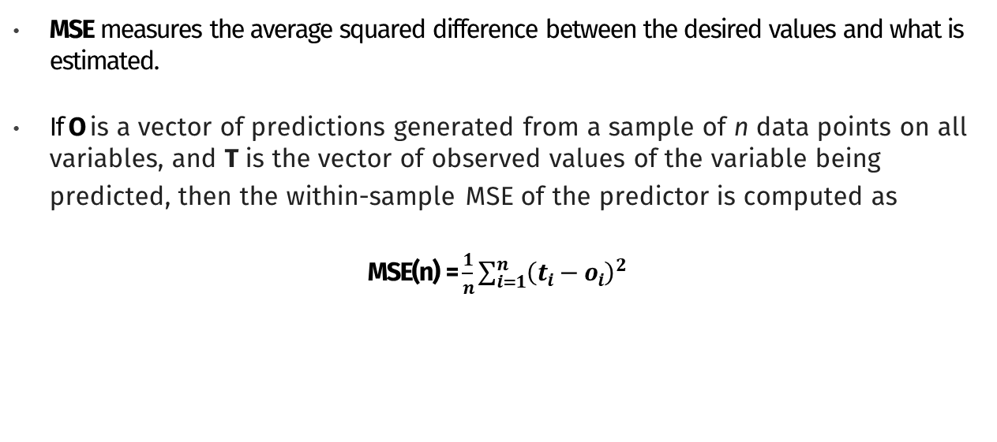
Mean Square Error (Cost function)

Slide 13
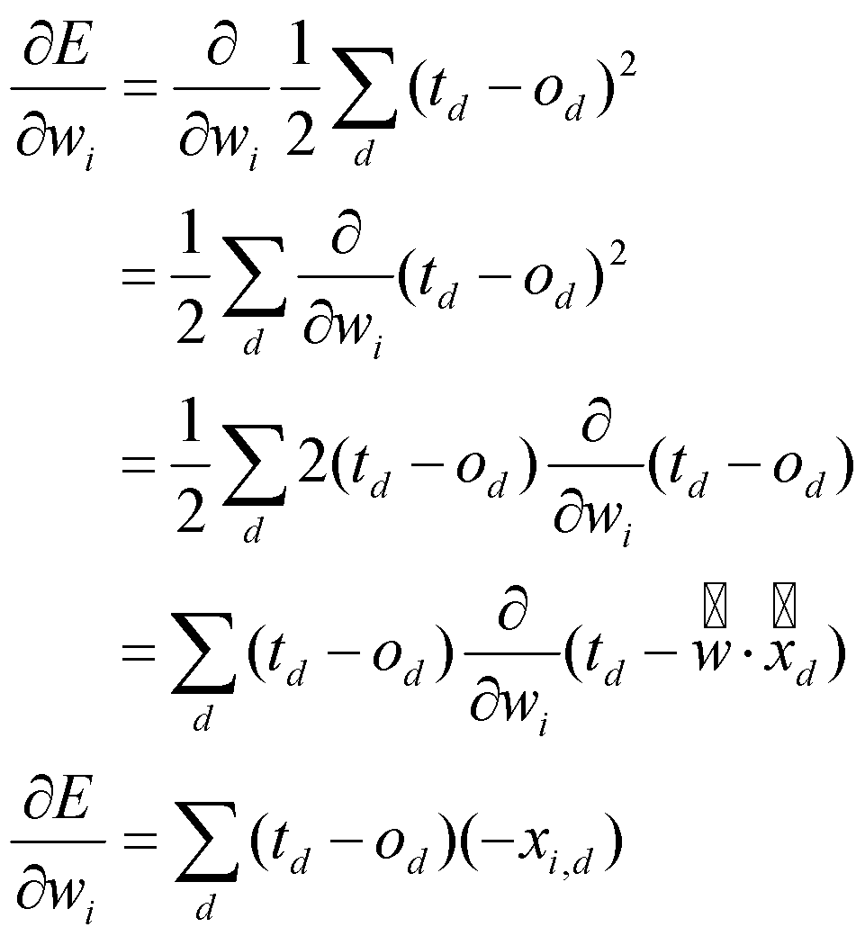
Mean Square Error Derivative (Gradient)

Slide 14
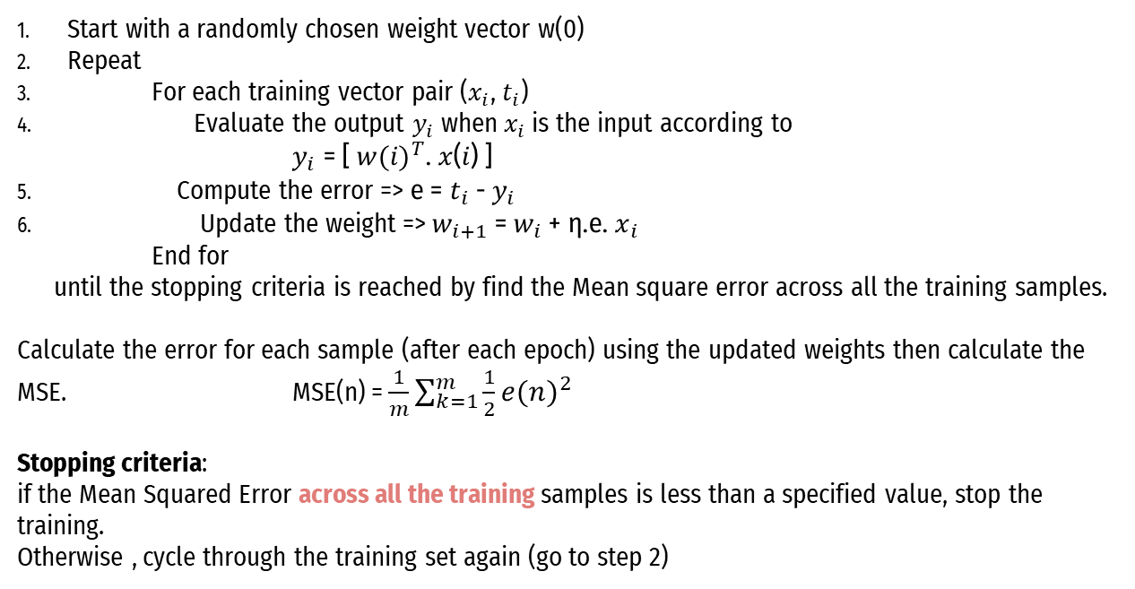
Adaline learning algorithm

Slide 15
What is in common ?
What is common between the Perceptron and the Adaline algorithms?
They are classifiers for binary classification
Both have a linear decision boundary
Both can learn iteratively, sample by sample (the Perceptron naturally, and Adaline via stochastic gradient descent)
Both use a threshold function

Slide 16
What is different ?
What is the difference between the Perceptron and the Adaline algorithms?
The Perceptron uses the class labels to learn model coefficients
Adaline uses continuous predicted values (from the net input) to learn the model coefficients, which is more “powerful” since it tells us by “how much” we were right or wrong
The Adaline, is similar to the perceptron, but their transfer function is linear rather than hard limiting. This allows their output to take on any value.
Perceptron fixes binary error; ADALINE minimizes continuous error.

Slide 17
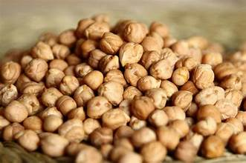
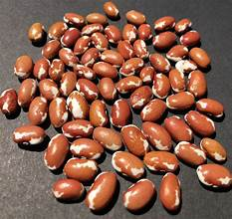
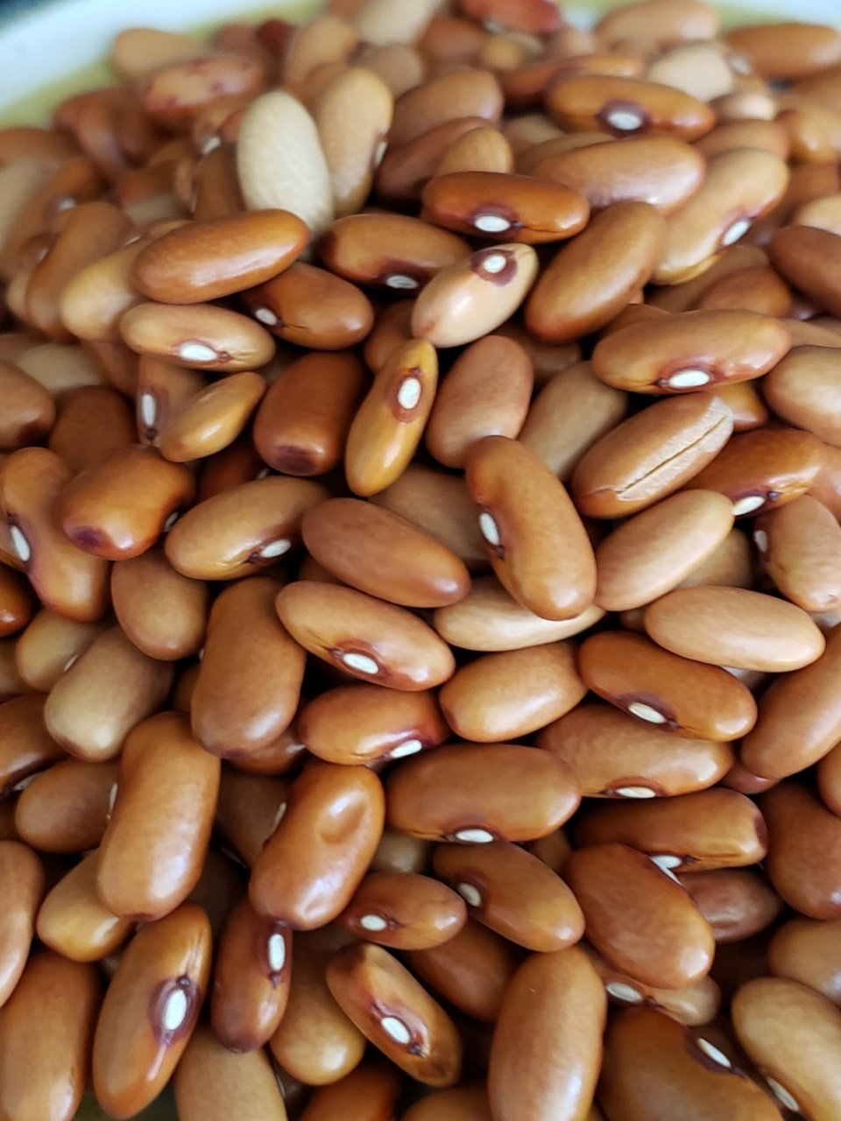
Task 1 – Dataset (Dry Beans)
The data set consists of 50 samples from each of three categories of Dry beans (Bomay, Cali and Sira).
Five features were measured from each sample: Are, Perimeter, MajorAxisLength, MinorAxisLength and roundness (in millimeter).
Bomay
Cali
Sira

Slide 18
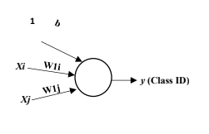
Task 1 - GUI
User Input:
Select two features
Select two classes (C1 & C2 or C1 & C3 or C2 & C3)
Enter learning rate (eta)
Enter number of epochs (m)
Enter MSE threshold (mse_threshold)
Add bias or not (Checkbox)
Choose the used algorithm perceptron or Adaline (radio button)
Initialization:
Number of features = 2.
Number of classes = 2.
Weights + Bias = small random numbers
Classification:
Sample (single sample to be classified).

Slide 19
Task 1 - Description
Implement the Perceptron learning algorithm
Single layer neural networks which can be able to classify a stream of input data to one of a set of predefined classes.
Use the Dry Beans data in both your training and testing processes. (Each class has 50 samples: train NN with 30 non-repeated samples randomly selected, and test it with the remaining 20 samples)

Slide 20
Task 1 - Description
Implement the Adaline learning algorithm using MSE
Single layer neural networks which can be able to classify a stream of input data to one of a set of predefined classes.
Use the Dry beans data in both your training and testing processes. (Each class has 50 samples: train NN with 30 non-repeated samples randomly selected, and test it with the remaining 20 samples)

Slide 21
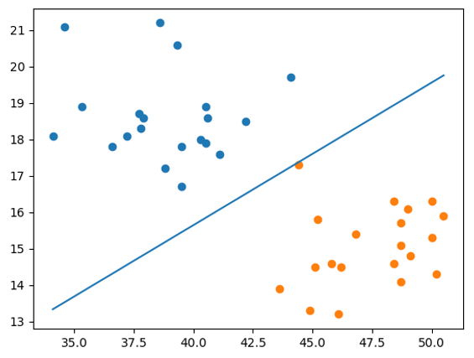
Task 1 - Description
After training
Draw a line that can discriminate between the two learned classes. You should also scatter the points of both classes to visualize the behavior of the line.
Test the classifier with the remaining 20 samples of each selected classes and find confusion matrix and compute overall accuracy.

Slide 22
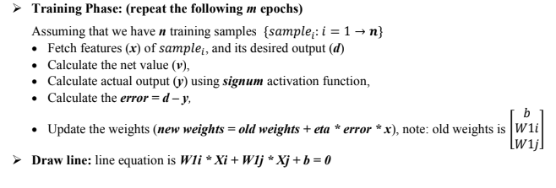
Task 1 – Workflow (Perceptron)

Slide 23
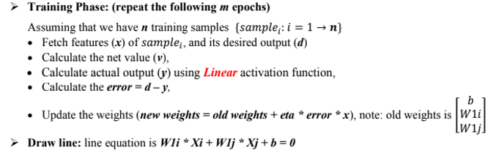
Task 1 – Workflow (Adaline)

Slide 24
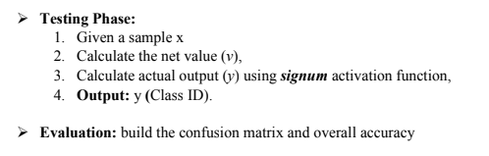
Task 1 - Workflow

Slide 25
Task 1 - Notes
You will be asked to deliver a .rar folder containing all your code files (.py), dataset and the visualization and analysis report.
In the report you should have screenshots/plots of the visualizations and a written analysis of what you understood from each of these visualizations and how the features discriminate or not between classes. You should have a plot and analysis for each combination (5 combinations for each algorithm)
At the end of the report, you should mention which features achieved the highest accuracy after running your algorithm.
You should not drop any row from the dataset.
Using scikit-learn metrics library or any similar built-in function for the confusion matrix is not allowed.

Slide 26
Task 1 - Notes
Lab 3 including Task 1 description will be available Thursday 26/10/2023. Task Deadline: 7/11/2023 11:59 PM
Please try to write well designed code.
Separate the logic (generation, loading, and classification) from the UI.
Writing well-documented, readable, maintainable, and extensible code is an extremely important skill you must master before graduating. So, don’t be lazy!
Cheating will not be tolerated.

Slide 27
Thank you

